Slide 1


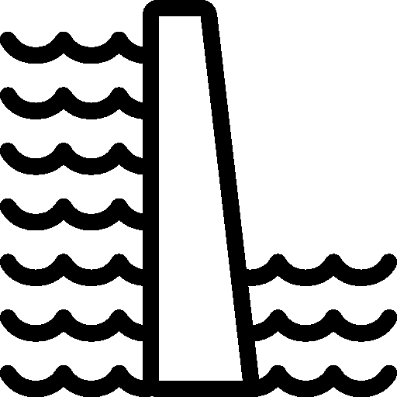

Natural inflow
Pumped
Outflows
Outflows
inflow
Water reservoir
Water reservoir
E
E
spill + env
spill + env
I
Q_{reg_inf}
S
Q_{reg_rel}
d
S
Q_{reg_rel}
d
Water reservoir
Water reservoir

Slide 2
Natural inflow
Outflows
Pumped
inflow
Water reservoir
E
E
I
spill + env
S
S
d
Q_{reg_rel}
d
Q_{reg_inf}
Water reservoir

Slide 3


Natural streamflow
Reservoir S1
Reservoir capacity = 21,544 ML
Catchment area = 28.8 Km²
Average natural inflow = 66 ML/day
Reservoir S2
Reservoir capacity = 5,662 ML
Catchment area = 18.2 Km²
Average natural inflow = 35 ML/day
Demand D
Average demand = 54 ML/day
Population = 150,000
I_{S1}
I_{S2}
Reservoir node
Q_{reg,S1,R}
S1
S2
Demand node
R
Q_{reg,R,S1}
Uncontrolled flow
Q_{reg,S1,D}
Q_{reg,S2,D}
Controlled flow
Pumped flow
D

Slide 4
Natural streamflow
I_{S}
Reservoir node
S
Demand node
Q_{reg,S,D}
Uncontrolled flow
Controlled flow
D

Slide 5
Natural streamflow
I_{S}
Reservoir node
Q_{reg,R,S}
S
Demand node
R
Q_{reg,S,D}
Uncontrolled flow
Controlled flow
Pumped flow
D

Slide 6
Natural streamflow
I_{S1}
I_{S2}
Reservoir node
Q_{reg,S1,R}
S1
S2
Demand node
R
Q_{reg,R,S1}
Uncontrolled flow
Q_{reg,S1,D}
Q_{reg,S2,D}
Controlled flow
Pumped flow
D

